Slide 1
CUCKOO HASHING
MEMBERS:
K. Shree Harini(23BIT089)(9517202306092)
S. Sowmiya Shivani(23BIT091)(9517202306096)
Varsha.G.A(23BIT096)(9517202306111)
Department of Information Technology
Mepco Schlenk Engineering College

Slide 2
AIM
To implement vanilla cuckoo hashing which includes 2-independent hash functions to create a hash table with minimum number of collisions.
To implement count sketches, to check if the random variables E[x] and E[y] are pairwise correlated or not

Slide 3
INTRODUCTION
Hashing is a technique used in data structures to efficiently store and retrieve data.
It involves transforming a given key (such as a number, string, or any other type of data) into an index in an array (called a hash table) using a hash function.
CUCKOO HASHING:
Cuckoo hashing moves or "kicks out" the existing element to make room for the new element, much like a cuckoo bird laying its egg in another bird's nest.

Slide 4
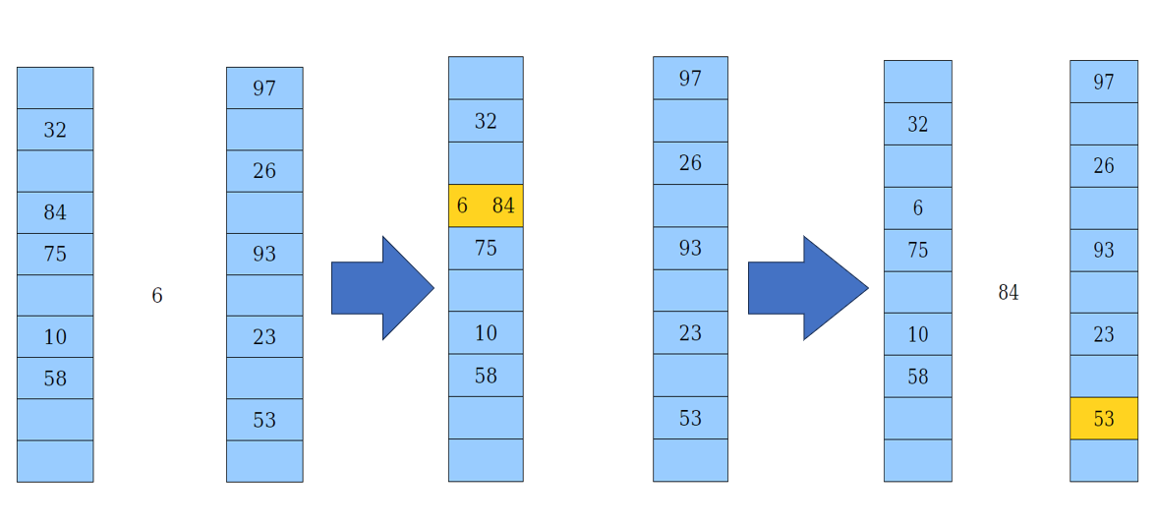
PICTORIAL REPRESENTATION

Slide 5
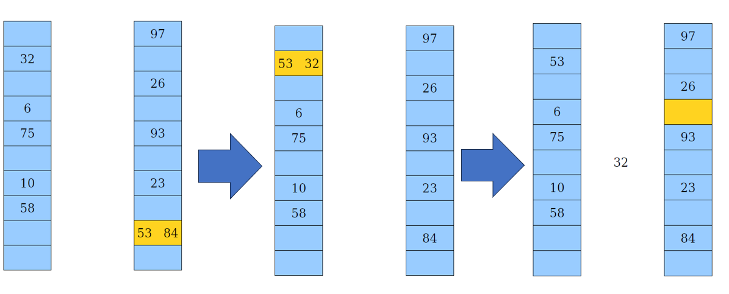
PICTORIAL REPRESENTATION

Slide 6
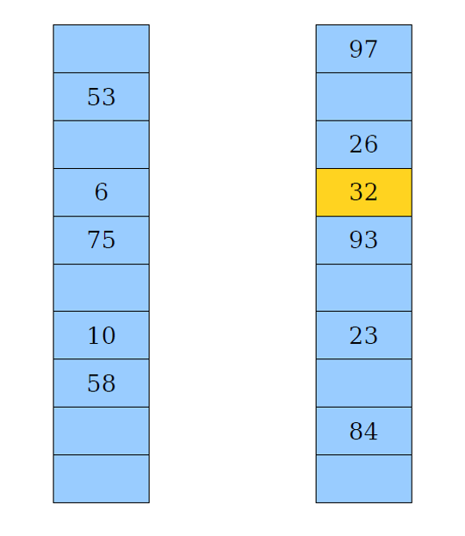
PICTORIAL REPRESENTATION

Slide 7
.
Pairwise uncorrelation:
It is a statistical property between two random variables, indicating they have no linear relationship with one another.
In other words, if two variables x and y are pairwise uncorrelated, the expectation of their product would be E[XY]=E[X]*E[Y].
This means that knowing the value of one variable doesn’t provide any information about the value of the other.

Slide 8
Problem Statement
The problem discusses cuckoo hashing, which is a way to store keys in a hash table. It highlights two challenges:
1. Finding two hash functions, h1 and h2, that always give different positions for the same key.
2. Moving a key to its new position correctly when it gets displaced should only require checking one of the hash functions.
The question also asks to prove that this method allows keys to be moved correctly between the two positions and that the chosen family of hash functions operates independently, ensuring even distribution of keys.

Slide 9
Problem statement
The task is to show that two specific random variables, involving different indices and drawn from independent hash functions, are uncorrelated. This means we need to prove that the expected value of their product equals the product of their expected values.

Slide 10
Module Explanation
Function 1: CuckooHashTable
Parameters used:
  Table1 and table2 → integer array that hold values in two tables
  m → size of each table
  size → tracks total number of elements inserted
  EMPTY → represents empty slot (-1)
Steps:
  The above function holds arguments which aid in the progress of the program, it also holds other modules, such as:

Slide 11
Module Explanation
Hash 1
  It is the primary hash function that determines an index for a key in table1
  Hash function -key%m.
Hash 2
  It is the secondary hash function for table table2
  It applies XOR operation on hash1(key) with a fixed delta and then the result modulo m.
  Hash function- (hash1(key)^delta)%m
  The main purpose of secondary hash function is to produce a different hash location if collision occurs in the primary table.
  The delta value employed is 3,this small fixed value allows efficient computation.

Slide 12
Contd...
Function 2: rehash
Parameters used
  The old size of the table – m.
  Pointer oldtable1 points to table1 value.
  Pointer oldtable2 points to table2 value.
  New table1 and table2 are created.
Steps :
  Rehash is called when the load factor is high, it doubles the size of table.
  Lager arrays foe table1 and table2 and intializes all slots are empty, all elements from old table are reinserted and old tables are deleted.

Slide 13
Contd...
Constructor and destructor
  Constructor intializes m to the given initial_size and size to zero.
  If initial_size is not a positive power of two, it prints error and exits.
  table1 and table2 are allocated with size m, and all slots are set to empty.
  The destructor frees the memory allocated for table1 and table2 when the object is destroyed.

Slide 14
Contd...
Function 3: insert
Arguments called:
  key → size of the table
Steps:
  insert checks if the table’s load factor exceeds 50%. If it does, rehash is called.
  The primary hash (pos1) is calculated. If the slot in table1 at pos1 is empty, the key is inserted and the size is incremented.
  If pos1 in table1 is already occupied, the existing element is kicked out and the new element is inserted is inserted in table 2 using hash2.

Slide 15
Contd...
      This process continues until an empty spot is found or rehashing is required.
      Function 4: search
      Checks if key is in table1 or table2 with hash1 and hash2.
      It returns Boolean value.
      Function 5:display
      Prints both tables, showing(.)for empty slots and displays the current load factor.

Slide 16
Contd...
Function 6: checkpairwiseuncorrelation
Parameter used:
  index1 → index of element 1
  index2 → index of element 2
  tablenum1→ number indicating the first entered table
  tablenum2→ number indicating the second entered table
Steps:
  This function calculates a pairwise expectation for the element in the specified table and index.
  Checking the conditions:
    tablinum>=0

Slide 17
Algorithm and implementation
Overview:
A Cuckoo Hash Table is a data structure used to store keys (or unique items) for quick access. It uses two hash functions to map keys to two different tables. This technique helps manage collisions (when two keys attempt to occupy the same space) efficiently.
STEP 1- Class Setup:
- The Cuckoo Hash Table consists of two arrays (or tables) for storage, both of which have a fixed size.
- It also keeps track of the current number of elements and has a predefined constant to indicate empty slots.

Slide 18
Contd...
STEP 2- Initializing the Hash Table:
- When creating the Cuckoo Hash Table, you specify the initial size for both tables. This size should be a power of two (like 2, 4, 8, etc.) for optimal performance.
Both tables are set to empty at the beginning.
STEP 3- Hash Functions:
- The algorithm defines two hash functions:
- First Hash Function: This function takes a key and calculates an index in the first table using a modulo operation.
- Second Hash Function: This function calculates an index in the second table using a different method, involving XOR operation with a constant and modulo.

Slide 19
Contd...
STEP 4 -Inserting Keys:
- When inserting a key:
1. The algorithm first checks if the current load factor (number of keys divided by table size) exceeds a certain threshold. If it does, it triggers a rehashing operation to expand the tables.
2. The algorithm uses the first hash function to find an index for the key in the first table.
3. If that index is free (empty), the key is placed there. If it is occupied (a collision happens), the current key at that index is evicted (removed) and moved to its new location based on the second hash function.
4. The newly evicted key is then placed in the second table using the second hash function.
.

Slide 20
Contd...
- This process continues, where keys may swap places multiple times until a free spot is found.
STEP 5- Searching for Keys:
- To find a key:
1. Use the first hash function to check the first table.
2. If the key isn’t found there, use the second hash function to check the second table.
3. The search stops once the key is found or both tables have been checked.

Slide 21
Contd...
STEP 6-Rehashing:
- If the load factor exceeds a predefined level (indicating the table is getting full), the hash tables are resized. The size is doubled, and all existing keys need to be reinserted into the new larger tables. This helps maintain fast access times.
STEP 7-Displaying the Table:
- The algorithm can display the contents of both tables along with other statistics, like the current load factor, which shows how full the table is.

Slide 22
Contd…
STEP 8-Checking Pairwise Uncorrelation:
- The algorithm includes a method to check if two keys at specific positions in the tables are statistically independent from each other. It calculates expectations based on their hash values and determines whether they are correlated.

Slide 23
SOLUTION(flowchart):
START
INPUT INITIAL SIZE
SIZE IS A POWER OF 2
N0
THROW EXCEPTION
YES
INITIALIZE TABLE 1&2

Slide 24
C
INSERT KEY
CHECKING LOAD FACTOR
(SIZE>=M/2)
No
COMPUTE POSITION IN TABLE1
Yes
REHASH
C

Slide 25
c
Check if pos1 is empty
No
Store current key and compute position in table 2
Yes
Insert key and increment size
Check for pairwise uncorrelation
End

Slide 26
APPLICATIONS
Caching Systems
Memory Management
Networking Applications
Database Indexing
Distributed Systems
Real-Time Analytics
Mobile and Embedded Systems
Blockchain and Cryptography Applications

Slide 27
SUMMARY
The Cuckoo Hash Table algorithm is a clever way to handle storage and retrieval of keys using two hash functions and a process of evicting keys when collisions occur. It includes mechanisms for resizing the storage when it gets too full and allows statistical analysis of keys stored in the tables. Overall, it provides efficient access and management of data.

Slide 28
Source Code
Source code link:pdfMini project code.docx

Slide 29
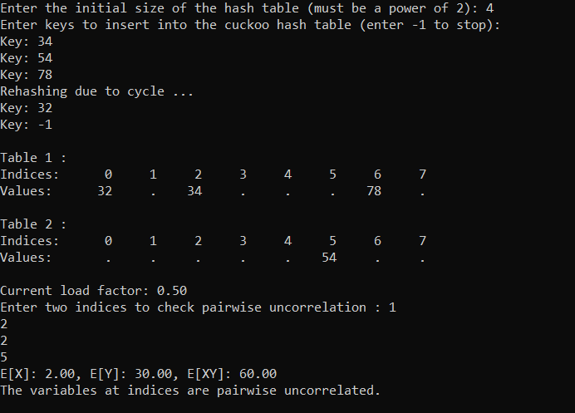
Output screenshots

Slide 30
REFRENCES
      1.Data Structures and Algorithm Analysis in C++ by Mark Allen Weiss
      2.Algorithms and Data Structures: The Basic Toolbox by Mehlhorn and Sanders.
      3.Introduction to Algorithms by Thomas H. Cormen, Charles E. Leiserson, Ronald L. Rivest, and Clifford Stein (CLRS)
      4.Handbook of Data Structures and Applications by Dinesh P. Mehta and Sartaj Sahni .
      5.Cuckoo Hashing" by Rasmus Pagh and Flemming Friche RodlerI.
      6.Advanced Data Structures by Peter BrassR.
      7.C++ Primer by Stanley B. Lippman, Josée Lajoie, and Barbara E. MooM.

